Slide 1
Analysis of Open Source Video Conferencing Tools with Moodle
By:
Anto Loyola
Jessica Patel

Slide 2
Abstract
The Moodle architecture is studied first and continuing on a particular tool is selected based on the evaluation of each ones characteristics and the easy merge with Moodle architecture. This study will be further extended to create a video conferencing and screen sharing plug-in for Moodle.

Slide 3
Agenda
What is Moodle?
Moodle Architecture
Moodle Blocks
Activity Module
Opensource Video Conferencing Tools
OpenMeetings Architecture
Integration

Slide 4
What is Moodle?
Modular Object-Oriented Dynamic Learning Environment
Free source e-learning software platform
Also known as a Course Management System, Learning Management System, or Virtual Learning Environment (VLE).
Originally developed by Martin Dougiamas
Moodle mostly follows a transaction script approach
Notes:
Martin Dougiamas - help educators create online courses with a focus on interaction and collaborative construction of content, and is in continual evolution.

Slide 5
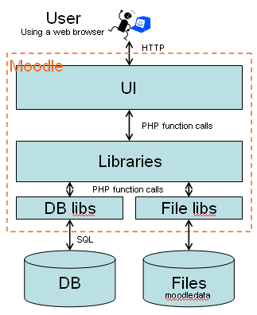
Moodle Architecture
Physically, a Moodle plug-in is just a folder of PHP scripts (and CSS, JavaScript, etc. if necessary).
Moodle core communicates with the plug-in by looking for particular entry points, often defined in the file lib.php within the plug-in.

Slide 6
Moodle Architecture – Core Components
Database abstraction layer
Roles and Capabilities system for controlling who can do what
Forms library for creating accessible and secure HTML forms that let users edit things
File API for managing files stored by Moodle
The database schema
What happens when you require config.php
lib/moodlelib.php
lib/weblib.php for outputting
Notes:
Talk about moodle blocks

Slide 7
Module Blocks
One of the most important types of plug-ins.
Small bits of functionality that can be added to the sides (normally) of other pages. Many blocks provide views of data that is available elsewhere. Blocks live in the blocks folder.
A few commonly seen blocks:
Activities, Admin Bookmarks, Blog Tags, Calendar, HTML, Latest News, Mentees Block, etc.

Slide 8
Activity Module
An administrator can manage Moodle's activity modules for the site in Settings > Site administration > Plug-ins > Activity modules > Manage activities, including any contributed modules that have been added.

Slide 9
Open-source Video Conferencing Tools
Multiple tools have been assessed based on factors as,
Platform Dependency
Compatibility
System Requirements
Installation
Configuration
Ease of Use
Performance

Slide 10
Open-source Video Conferencing Tools..
Tools that have been tested,
Adobe Lccs (Livecycle Collaboration Service)
Flazr
Ajax Chat
Big Blue Button
Openfire - Red5 Chat
Redfire 03 & Redfire 06
Sparkweb
Openmeetings

Slide 11
Adobe Lccs (Livecycle Collaboration Service)
Add collaboration to new and existing applications. Some examples of applications with collaborative capabilities include social games, e-learning solutions, and sports broadcasts.
Features
Easily integrate text chat, whiteboard, webcam, and VoIP functionality.
Rapidly build and deploy applications with the complete SDK.
Manage user and session data.
Build your applications in the best-of-breed mix of onsite and cloud environments.

Slide 12
Adobe Lccs (Livecycle Collaboration Service) - Factors
Platform Dependency: currently supports Macintosh, Windows (3.1, 95, NT), and UNIX (HP-UX, SunOS (TM), Solaris (r), IBM (R), AIX (R)) platforms.
System Requirements: Minimum System Requirements for Macintosh and Power Macintosh Users
Macintosh with a 68020 or greater processor, or a Power Macintosh
3.5 MB of RAM (5 MB for Power Macintosh) available to Acrobat Reader
Apple System Software version 7.1 or later.

Slide 13
Adobe Lccs (Livecycle Collaboration Service) - Factors..
Installation: Required each Moderator and each Client to have a Adobe LCCS account to be able to login and use web services
Configuration: Requires Each Client Computer to download a Adobe SDK file inorder to use its services
Ease of Use: Not very easy to use
Performance: Flash makes performance a little slow

Slide 14
Big Blue Button
An open source web conferencing system developed primarily for distance education.
Features,
Multiple audio and video sharing
Presentations with extended whiteboard capabilities - such as a pointer, zooming and drawing
Desktop sharing
Integrated voip using asterisk or freeswitch
Two user roles: viewer or moderator

Slide 15
Big Blue Button - Factors
Platform Dependency: platform independent implementation for desktop sharing.
System Requirements: dual-core machine with at least 2 GB of memory and a 2.0+ Ghz processor for good upstream and downstream bandwidth from the server (recommended - Ubuntu 10.04 32-bit/64-bit on the server )
Installation: Very Huge download and installation procedure even for Linux

Slide 16
Big Blue Button - Factors..
Configuration: Requires a change of much of the code to get a tolerable performance and hence requires too much initial configuration
Ease of Use: Slowness makes it difficult to use
Performance:
The viewers never have access to the conference if it is configured to have to wait for connecting the moderator.

Slide 17
Openfire - Red5 Chat
Openfire - is an XMPP server written in Java and dual-licensed under both a proprietary license and the Apache License 2.0.
Red5 - full FLASH video chat with audio and video support made using Open Source RED5 technology and Flash

Slide 18
Openfire - Red5 Chat..
Features,
No plugin
Private Messages
Registration process
No duplicate entries
Full customized design
Multi langage chat
is watching me feature
4 webcams
Rooms

Slide 19
Openfire - Red5 Chat - Factors
Platform Dependency: Completely Independent
System Requirements: The server should be a high configuration which is dependent on the load that is expected by the number of clients
Web server with PHP/mySQL
Windows or Linux dedicated server
Installation: Requires PHP and MYSQL and the setup of the Red5 Server

Slide 20
Openfire - Red5 Chat - Factors..
Configuration: Requires the PHP files to be modified to the MYSQL database and the Server to be Configured to our own server
Ease of Use: Easy to Use and customize
Performance: It is fast as it is only the basic services that are provided.
Existing Errors: Requires other methods to support logging in and choosing the chat partners and other specifications
Future Enhancement: Should be made to a ready made chat application with easily customizable options. Use HTML5.

Slide 21
Openmeetings
OpenMeetings is software used for presenting, online training, web conferencing, collaborative whiteboard drawing and document editing, and user desktop sharing. OpenMeetings is suitable for any work environment.
Based on OpenLaszlo RIA framework and Red5 media server, which in turn are based on a bunch of open source components. Communication takes place in meeting rooms which are set to different communication, security and video quality modes.

Slide 22
Openmeetings..
Features,
Audio Video conferencing – select modes
Meeting recording
Collaborative document editing
Polls and Voting
Chat and whiteboarding
Backup

Slide 23
Openmeetings..
Advantages:
Real Open Source
Recordings can be downloaded as AVI/FLV
Chat and private messaging
Calendar with Notification System (EMail or Ical)
Multicolor Interface and easy branding and 30++ Languages and Language Editor
SOAP-Integration API
Ready to run LDAP and MS Active Directory Support

Slide 24
Openmeetings - Factors
Platform Dependency: Windows, MacOS or Linux
Compatibility: Platform independent
System Requirements: The server should be a high configuration which is dependent on the load that is expected by the number of clients
Installation: A basic server startup Batch file (shell file for Linux) and then server side direct installation.

Slide 25
Openmeetings - Factors..
Configuration: Minimum tweaks to make the performance faster. These can be ignored for most part for usages over the intranet.
Ease of Use: Very easy and self-explanatory in usage and installation.
Performance: Desktop Sharing is extremely fast (compared to all other tools we tried) as it is Java WebStart application and directly runs on the client without any need of installation.
Future Enhancement: More options on restricting the usability on users.

Slide 26
Openmeetings – Improving Performance
Linux Operating System provides higher performance on most servers.
To use the optimum of performance from your server there is a start-script for red5 available that does some basic settings in the JVM. It is called red5-highperf.sh. It is recommended to use that script for production and high-load scenarios.
#!/bin/bash if [ -z "$RED5_HOME" ]; then export RED5_HOME=.; fi # Previous option set export JAVA_OPTS="-Xrs -Xms512M -Xmx1024M -Xss128K -XX:NewSize=256m -XX:SurvivorRatio=16 -XX:MinHeapFreeRatio=20 -XX:+ExplicitGCInvokesConcurrent -Djava.net.preferIPv4Stack=true -Xverify:none"

Slide 27
Openmeetings – Improving Performance..
# start Red5 echo "Setting Hi Performance Options" exec $RED5_HOME/red5.sh >> $RED5_HOME/log/jvm.stdout 2>&1 &You have to exclude the "-XX:+UseConcMarkSweepGC" param from the default red5-highperf.sh to make it functional! However if you are a performance expert you might also play with the values to find perfect matches for your use-case.
You have to exclude the "-XX:+UseConcMarkSweepGC" param from the default red5-highperf.sh to make it functional! However if you are a performance expert you might also play with the values to find perfect matches for your use-case.

Slide 28
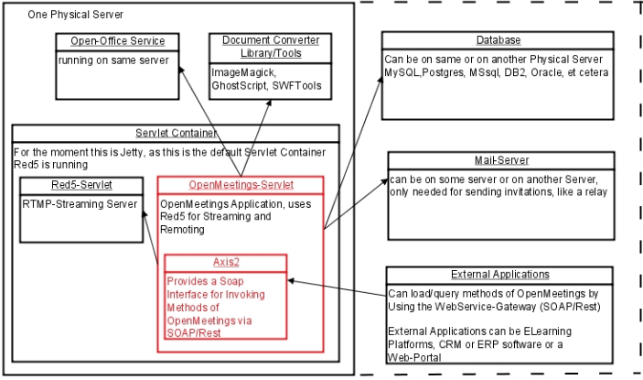
OpenMeetings Architecture

Slide 29
Integration
The college now contains
A running Moodle on Xampp server
An email server
Now a Red5 Server is required which will run Openmeetings
The Clients will need to only access the Moodle server
So the Xampp Server will be made public and the Openmeetings Server will be made on the localhost so that the required action can be done only through Moodle and the clients will not be able to access Openmeetings directly

Slide 30
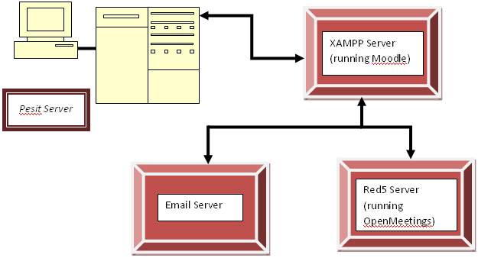
Integration..

Slide 31
Thank You!

